Slide 1

DESIGN AND OPTIMIZATION OF FOUR PORT ANTENNA FOR 5G APPLICATIONS
Project ID: CMA-6
Project Guide: Dr. Niraj Kumar
By,
Asim Anand-21BEC1519
Akash Singh-21BEC1542
Ayushi Datta-21BEC1471
Guide’s Signature

Slide 2
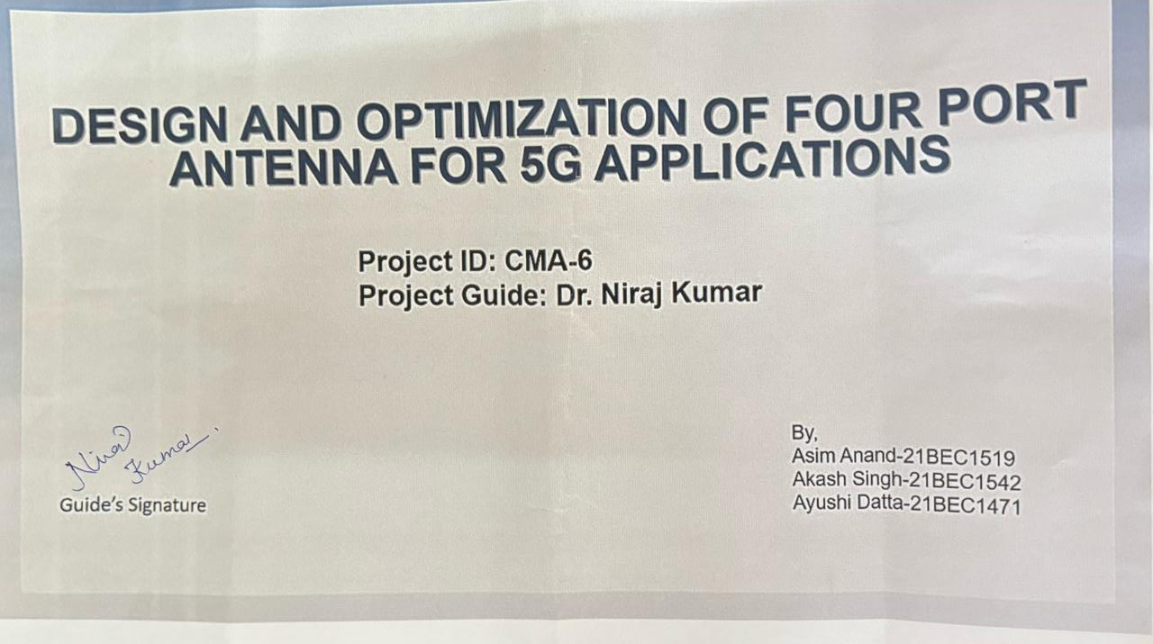

Slide 3
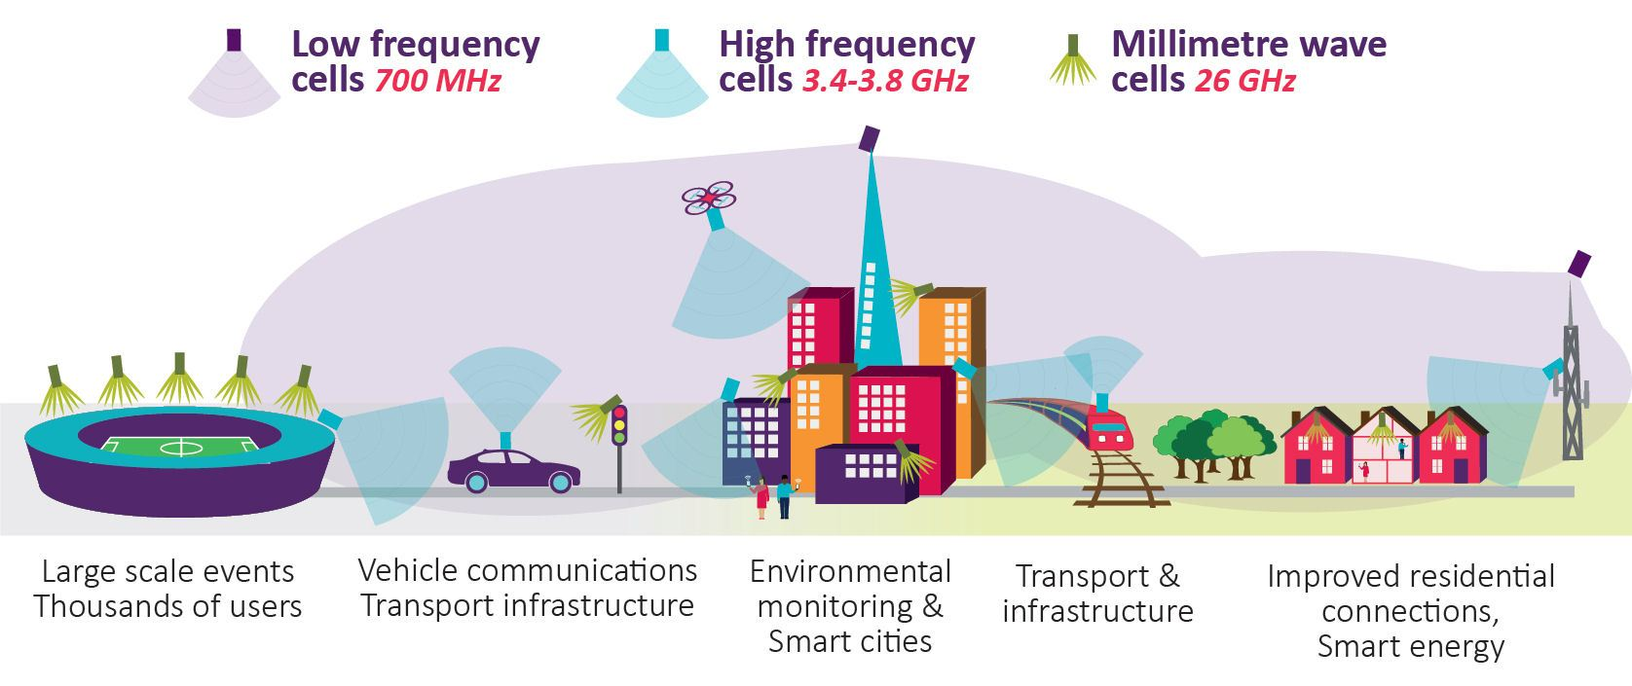
INTRODUCTION
The rapid advancement of technologies like smartphones, medical devices, security systems, and wearables has led to a growing demand for 5G-enabled devices for high-speed, reliable, and efficient communication
To meet these requirements, multiple-input multiple-output (MIMO) antenna systems have emerged as a fundamental component in modern communication infrastructures.
Among the various frequency bands allocated for 5G, the sub-6 GHz spectrum, particularly the 3–5 GHz band, has gained significant attention due to its balanced characteristics of coverage and bandwidth.

Slide 4
PROBLEM STATEMENT
The rapid advancement of technologies like smartphones, medical devices, security systems, and wearables has led to a growing demand for 5G-enabled devices for high-speed, reliable, and efficient communication.
Existing MIMO antennas often struggle to achieve triband performance at higher frequency bands, which are crucial for 5G applications, limiting their effectiveness in high-speed data transmission.
Achieving wideband operation (e.g., 3–5 GHz) while maintaining good impedance matching (S11 < –10 dB) and high isolation (>15 dB) among multiple ports remains a challenging task in MIMO antenna design.
There is a need for a compact, simple, and efficient four-port MIMO antenna design that meets the performance criteria for next-generation 5G systems and can be effectively validated through simulation tools like HFSS.

Slide 5
RESEARCH OBJECTIVE
To design a compact four-port MIMO antenna operating in the 3–5 GHz frequency range suitable for sub-6 GHz 5G applications.
To ensure efficient impedance matching across the desired band with return loss (S11–S44) values less than –10 dB.
To minimize mutual coupling between antenna elements and achieve high isolation (>15 dB) through strategic element placement and structural modifications.
To evaluate the MIMO performance metrics, such as Envelope Correlation Coefficient (ECC), Diversity Gain (DG), and Channel Capacity Loss (CCL), ensuring the design meets 5G standards.
To develop a step-by-step antenna design flow, starting from a single-port antenna, expanding to two-port, and finalizing with a four-port configuration for better design understanding and control.

Slide 6
Four port MIMO Antenna Design
It is based on Microstrip Antenna. Total Size is 36 mm x 42 mm. Four port microstrip antenna designed and simulated using Ansys HFSS.
The antenna structure consists of a radiating patch, feed lines, and a specialized ground plane with an Electromagnetic Band Gap (EBG) structure to enhance isolation and performance. Both are printed on a 1.4 mm thick FR4 dielectric substrate and dielectric constant of the material is 4.4 .

Slide 7
PROPOSED SYSTEM
The proposed system focuses on the design and simulation of a compact four-port MIMO antenna tailored for 5G wireless communication within the 3–5 GHz frequency band.
The antenna is developed in a progressive manner, starting from a single-port design, evolving into a two-port configuration, and finally achieving a symmetrical four-port MIMO layout. This step-by-step approach allows for better optimization and control over critical performance parameters.
The primary goal of the proposed system is to deliver high isolation, broad impedance bandwidth, and low envelope correlation between ports, which are essential characteristics for a high-performance MIMO antenna system. The antenna is designed using HFSS (High-Frequency Structure Simulator), leveraging its accurate 3D electromagnetic simulation capabilities.

Slide 8
PROPOSED SYSTEM
The key design considerations in the proposed system include:
Compact structure for easy integration into portable 5G-enabled devices.
Orthogonal placement of antenna elements to reduce mutual coupling.
Ground plane modifications (such as slots or stubs) to enhance isolation between ports.
Use of a common substrate with symmetric layout to maintain uniform performance across all ports.

Slide 9
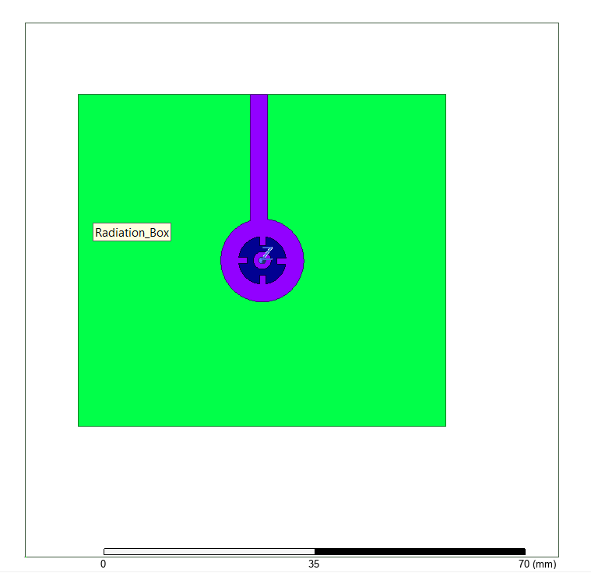
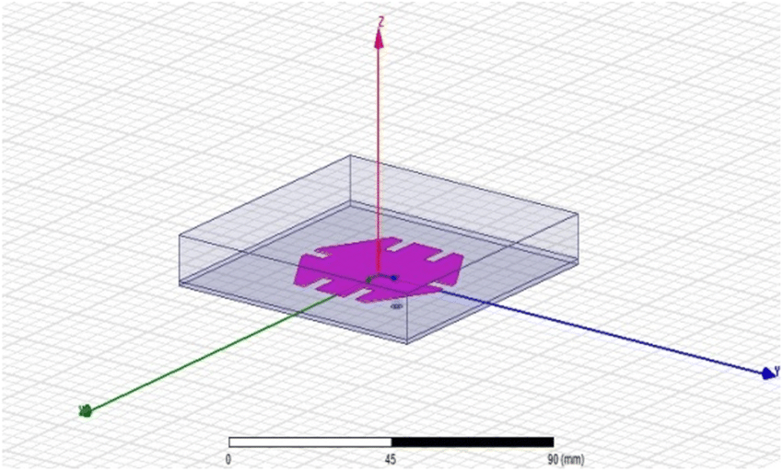
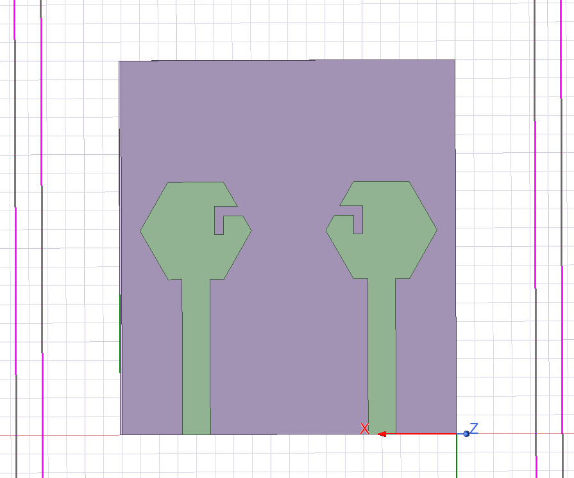
Proposed Layouts

Slide 10
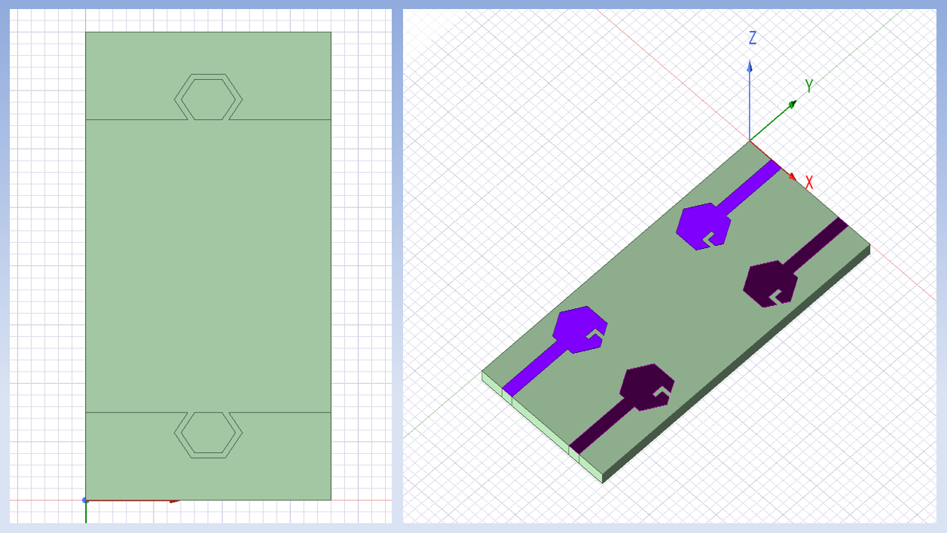
FINAL SCHEMATIC

Slide 11
Antenna Design Overview
1. Ports & Feeding Mechanism:
The antenna has four ports, each connected to a rectangular microstrip feed line.
2. Radiating Patch:
The radiation patch comprises four identical, symmetrical structures, each resembling a modified wrench-like shape.
These radiating elements are printed on the top surface of the substrate, contributing to the overall performance of the antenna.
3. Ground Plane with EBG Structure:
The bottom layer of the design features a partially covered ground plane with an EBG (Electromagnetic Band Gap) structure.
The EBG structure is hexagonal, which helps in reducing surface waves and improving isolation between radiating elements.
The ground plane design ensures better impedance matching and enhanced radiation characteristics.

Slide 12

ANTENNA DIMENSIONS
W3
L2
W5
W2
W4
Parameter | Value (mm)
L1 | 16.6
L2 | 3
W1 | 3
W2 | 6
W3 | 2.5
W4 | 1
W5 | 2.077
W1
L1

Slide 13

L
Parameter | Value (mm)
L (Length) | 42
B (Breadth) | 36
S (Separation) | 17
S
B

Slide 14
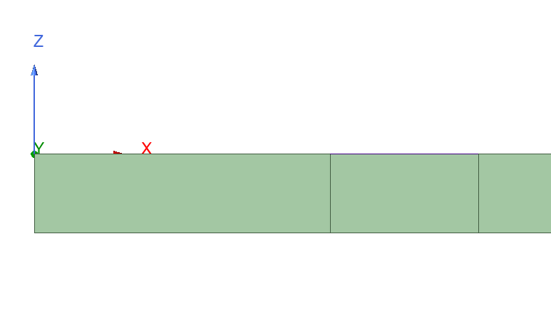
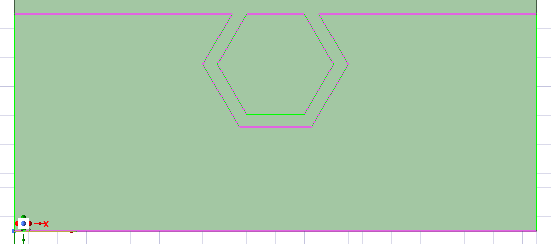
W2
L2
Parameter | Value (mm)
L1 | 4
L2 | 1.6
W1 | 1
W2 | 3
W1
L1
L1

Slide 15
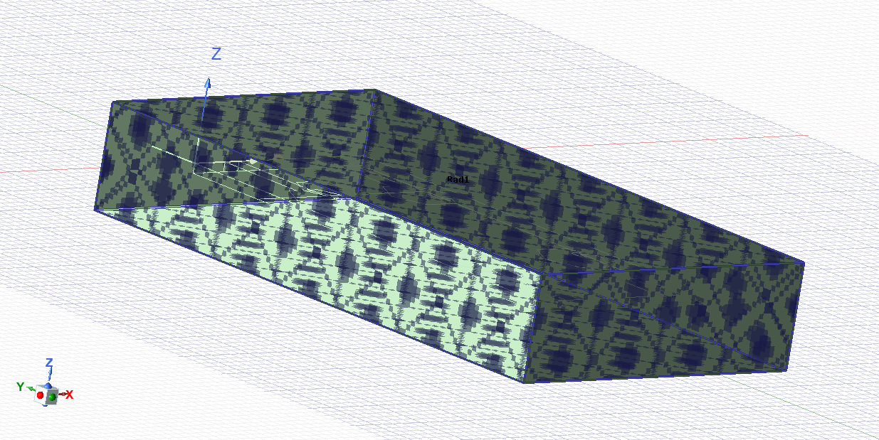
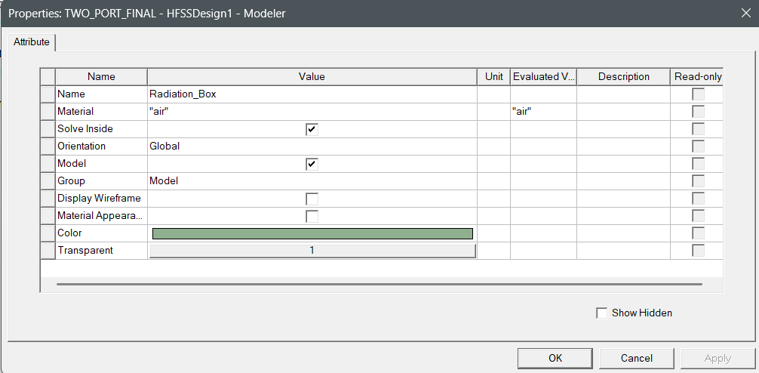
Dimensions of Designed MIMO Antenna
Substrate Used | Parameters
 | Dielectric Constant | Dielectric Height | Frequency Spectrum
FR4 Epoxy | <4.4 | 1.6 mm | 3-5 GHz

Slide 16
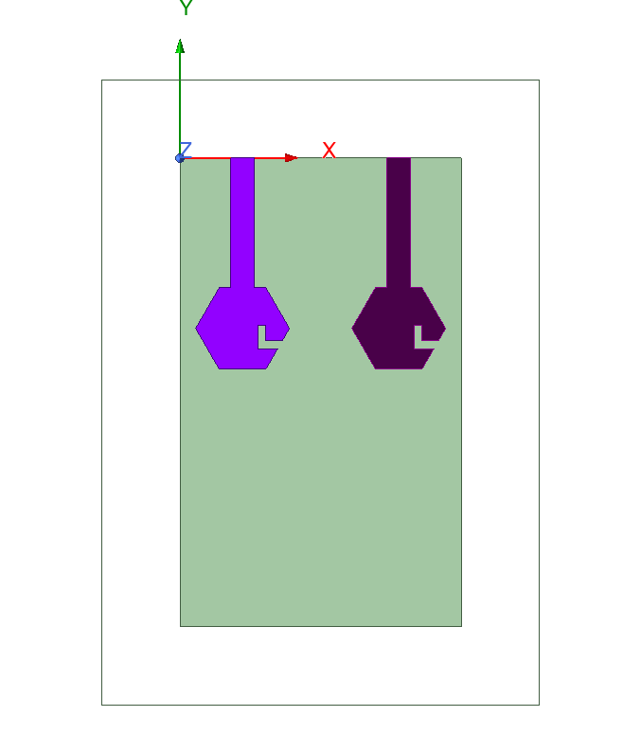
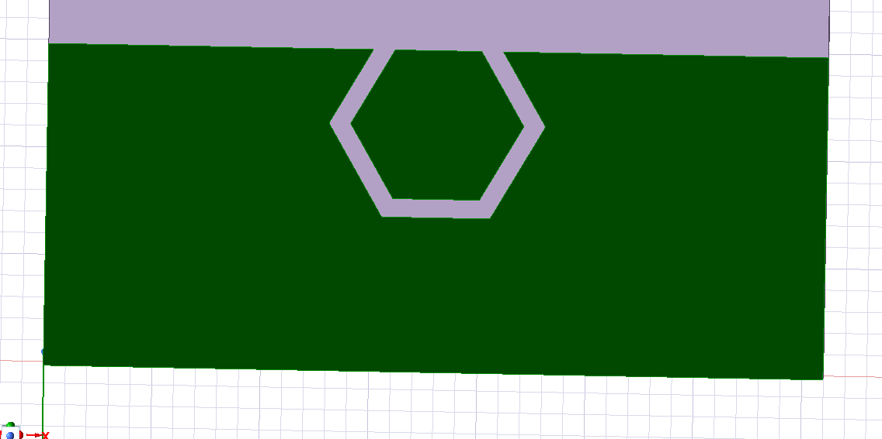
TWO PORT DESIGN

Slide 17
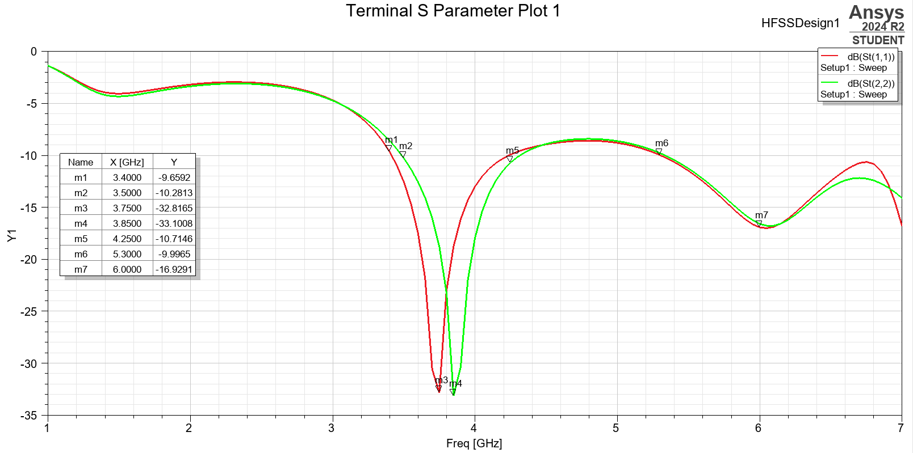
Output Graph Obtained for Two Port

Slide 18
S PARAMETERS
S(1,1) (Red) → Reflection coefficient of port 1.
S(2,2) (Green) → Reflection coefficient of port 2.
The S11 (red) and S22 (green) curves show that both ports have return losses well below -10 dB across a range (3.4–4.25 GHz), ensuring good signal acceptance and minimal reflection at those frequencies.
The deep notches around 3.75 GHz (m3, m4) with S11 and S22 values below -30 dB indicate strong resonance and excellent impedance matching at this frequency for both ports, confirming effective operation.
The near-overlap of S11 and S22 suggests symmetrical behavior between the two ports, which is desirable in MIMO antenna systems for uniform performance.
While the strongest resonance is near 3.75 GHz, acceptable performance (S < -10 dB) is seen from roughly 3.4 GHz to 4.25 GHz, indicating moderate wideband characteristics suitable for applications in that band

Slide 19
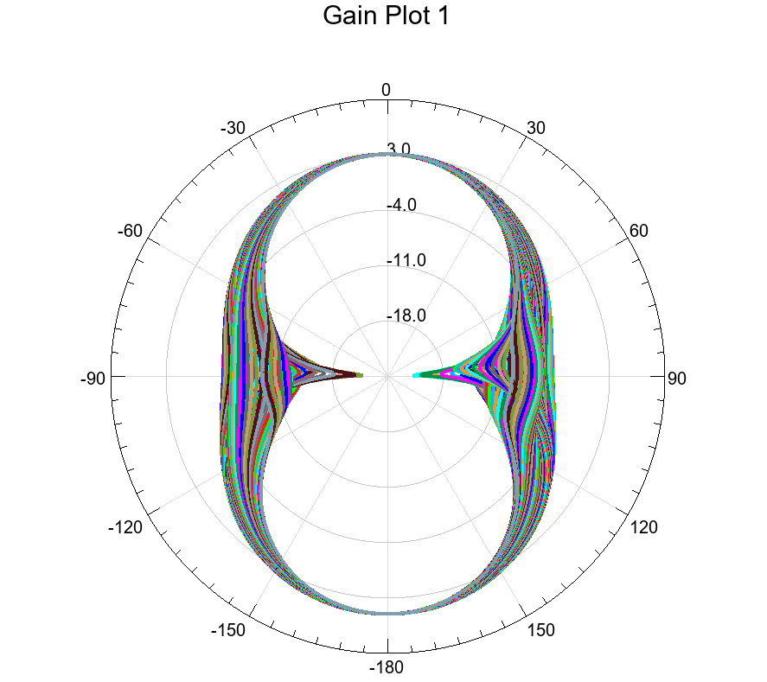
GAIN PLOT
Beam Symmetry: The gain plot is nearly symmetrical, indicating a balanced pattern, which is desirable for uniform coverage in MIMO systems.
Peak Gain: The plot indicates gain values reaching above 2.5 dB in the main direction and falls off symmetrically toward the sides, validating focused beam formation.
Multiple Cuts: The presence of multiple curves suggests gain cuts at various phi/theta angles, which helps visualize the full angular performance of the antenna.

Slide 20
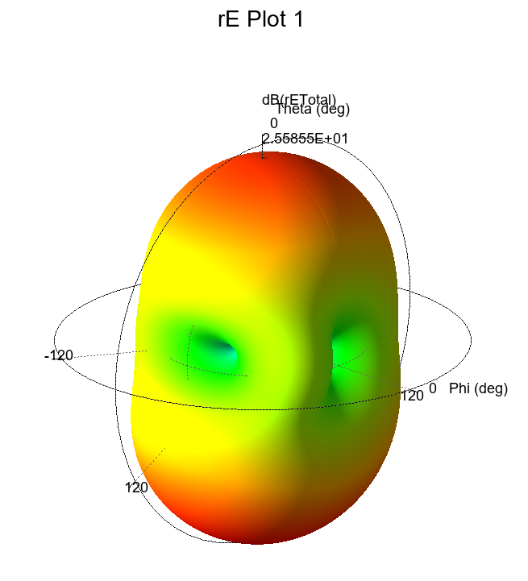
RADIATION PATTERN
Directional Behavior: The 3D radiation plot shows a relatively symmetrical and directional radiation pattern, indicating that the antenna radiates effectively in specific directions with minimal back radiation.
Peak Radiation: The maximum value reaches approximately 25.6 dB, demonstrating high gain and strong far-field radiation in the primary direction.
Color Coding: The red and yellow areas represent strong radiation zones, while green and blue indicate weaker fields, confirming well-defined lobes with good efficiency.

Slide 21
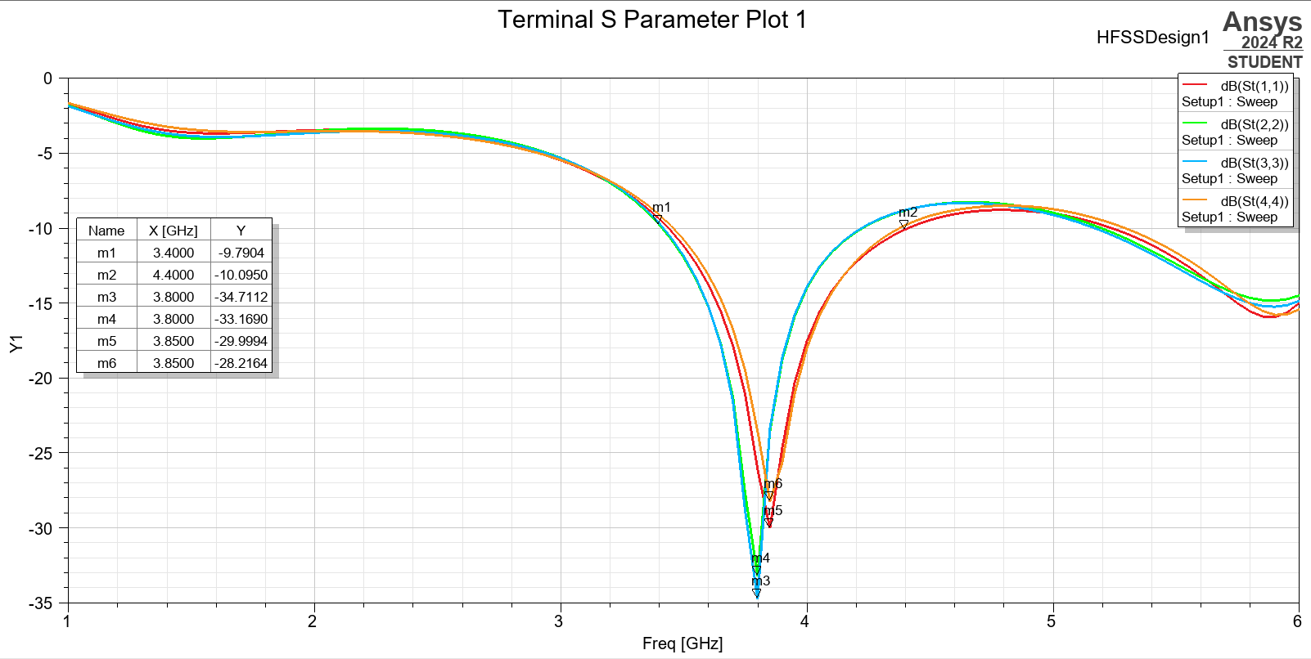
Output Graph Obtained for Four Port

Slide 22
S PARAMETERS
S(1,1) (Red) → Reflection coefficient of port 1.
S(2,2) (Green) → Reflection coefficient of port 2.
S(3,3) (Blue) → Reflection coefficient of port 3.
S(4,4) (Orange) → Reflection coefficient of port 4.
• All four S-parameters (S11, S22, S33, S44) exhibit strong resonant behavior around 3.8–3.85 GHz, with return loss values ranging from -28 dB to -34 dB, indicating excellent impedance matching and minimal reflection at each port.
• All ports maintain return loss below -10 dB over a similar frequency band, demonstrating uniform broadband behavior, crucial for MIMO applications to ensure synchronized performance.
• The S-parameter curves are closely aligned, signifying well-balanced design and symmetry among the four ports. This contributes to low mutual coupling and consistent isolation (even though isolation isn’t shown here, the return loss behavior supports it).
• The design shows strong performance in the 3.4 GHz to 4.4 GHz range, suitable for Sub-6 GHz 5G applications, confirming its effectiveness in the intended operating band.

Slide 23
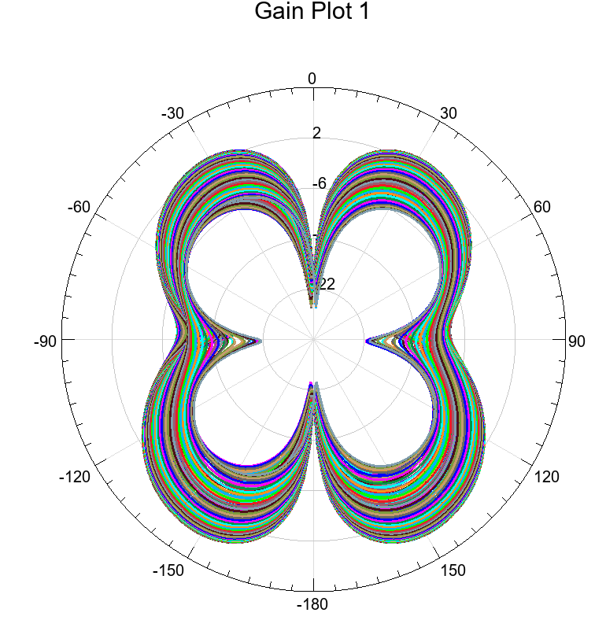
GAIN PLOT
The 2D polar gain plots indicate multiple symmetrical lobes, reinforcing the idea of multi-directional radiation.
The gain lobes show a flower shape in both azimuthal and elevation planes, suggesting broad angular coverage, which is crucial for consistent performance in varying user positions.
The gain levels are consistent and well-distributed, confirming uniform performance across elements.
The multiple overlapping plots (different ports or phi/theta cuts) indicate stable gain across all four ports, reinforcing the antenna's MIMO capabilities.

Slide 24
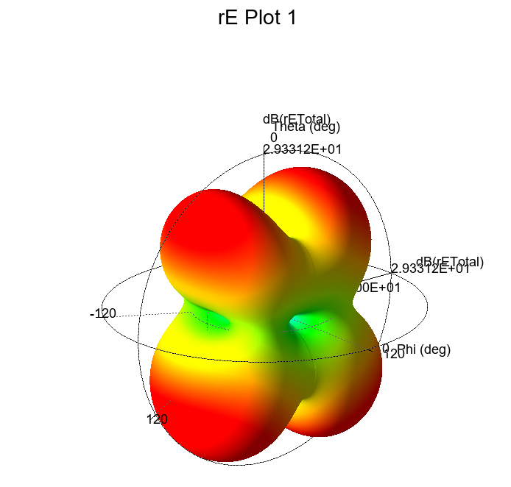
RADIATION PATTERN
The 3D radiation pattern for the four-port antenna (as shown in the last image) exhibits a distinct quad-lobed structure, indicating directional radiation in multiple planes.
The maximum value of the radiation is approximately 29.33 dB, which is quite significant and reflects strong directive characteristics, beneficial for beamforming in MIMO systems.
The color distribution (red for higher intensity, green for lower) confirms better field strength in desired directions and lower back radiation, which is ideal for spatial diversity in MIMO.
Such a structure suggests good spatial separation between elements, helping in reducing mutual coupling and improving overall system capacity.

Slide 25
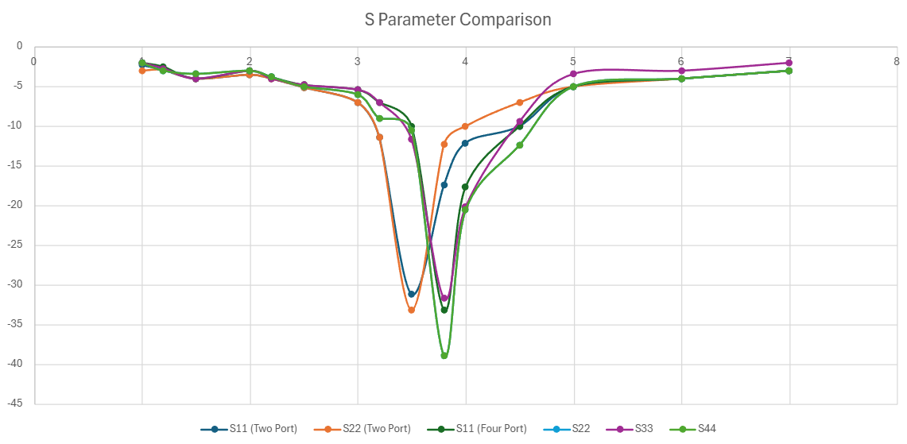
COMPARISON BETWEEN THE ANTENNAS

Slide 26
ANALYSIS
S11 (Two Port) and S11 (Four Port):
Both curves show how much power is reflected back at Port 1.
The deeper the dip (more negative the dB), the better the impedance matching (ideal is below -10 dB).
Four Port S11 dips lower (~ -40 dB), indicating better return loss compared to Two Port (~ -35 dB).
S22, S33, S44:
Represent return loss at Ports 2, 3, and 4 for the Four Port antenna.
All ports show good return loss, below -10 dB across a wide band, indicating efficient multiband performance.
Conclusion:
The Four Port antenna achieves better impedance matching and multiband characteristics than the Two Port version.
This confirms an improvement in overall antenna performance with the four-port MIMO design.

Slide 27
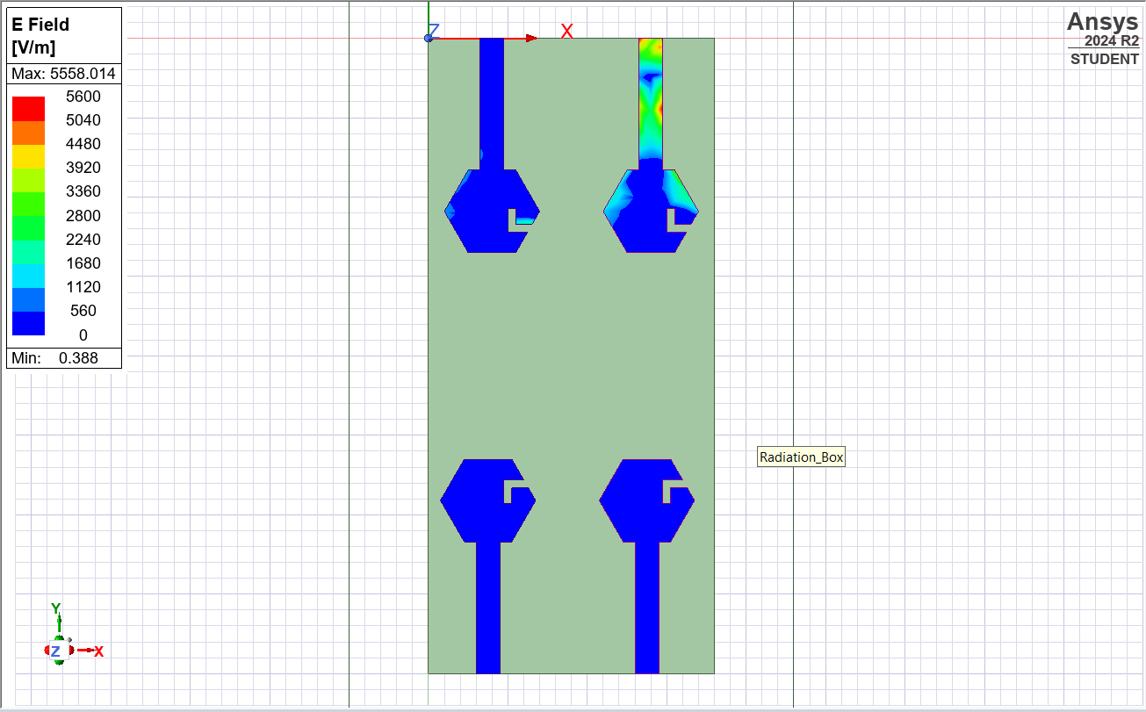
E Field across different patches
The plot llustrates the proposed MIMO antenna’s surface current distribution. If one of the ports is activated, the other is terminated by a 50 ohm matched load. From fig, it is observed that the first antenna has a high amount of surface current whereas the remaining antenna has a very low amount of surface current. This is due to the low mutual coupling and high port isolation between the two radiating antennas.

Slide 28
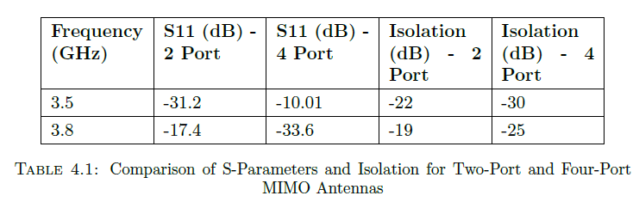
Bandwidth and Frequency Response • The two-port model provides a solid bandwidth but won’t necessarily maximize MIMO benefits in applications involving high rates of data. • A four-port antenna typically offers more bandwidth, better supporting 5G coverage of several frequency ranges. Radiation Pattern & Gain • The two-port system supports limited spatial diversity. • The four-port antenna significantly enhances MIMO diversity performance, making it more effective for 5G applications.
S Parameter Analysis • The two-port MIMO antenna experiences less element interaction, resulting in comparatively lower coupling. • The four-port MIMO antenna experiences better isolation methods but can experience increases in mutual coupling due to the added ports.

Slide 29

ECC (Envelope Correlation Coefficient) Calculation
Envelope Correlation Coefficient (ECC) is a key MIMO performance metric that tells you how independently the antenna ports radiate. For a good MIMO system, ECC should be very low (ideally < 0.1).
FOR FOUR PORT
Frequency (GHz) | ECC_12 | ECC_13 | ECC_14 | ECC_23 | ECC_24 | ECC_34
3.5 | 0.000723 | 0.00005 | 0.00021 | 0.00005 | 0.0001 | 0.000073
FOR TWO PORT
Frequency (GHz) | ECC
3.5 | 0.0001574

Slide 30
Standards Followed
Parameter | Requirement | Reference Source
Return Loss (S11) | < -10 dB | IEEE Std 149-1979
Isolation (S21) | < -15 dB | 3GPP TR 36.873
ECC | < 0.5 | ITU-R M.2135
Operating Band | 3-5 GHz

Slide 31
Conclusion
A compact and efficient Four-Port MIMO antenna has been successfully designed and simulated using HFSS to operate within the 3–5 GHz frequency band, relevant for emerging 5G sub-10 GHz applications.
The antenna exhibits good impedance matching with S₁₁, S₂₂, S₃₃, and S₄₄ values well below –10 dB within the operating band.
High isolation is achieved between ports (e.g., S₁₂, S₁₃, S₁₄ < –25 dB), indicating low mutual coupling and confirming suitability for MIMO systems.
The computed Envelope Correlation Coefficient (ECC) values are < 0.001, ensuring excellent diversity performance.
The antenna is compact, symmetric, and suitable for integration into modern 5G communication modules and IoT-based wireless devices.

Slide 32
FUTURE WORKS
Adapt the antenna design for operation in the 3–5 GHz range to support Sub-6 GHz 5G applications.
Optimize patch geometry and feeding techniques for improved bandwidth and gain in the lower frequency band.
Implement the antenna on flexible substrates (e.g., polyimide, PDMS, textile) for wearable electronics integration.
Investigate antenna performance under dynamic conditions like bending, stretching, and proximity to human tissue.
Explore miniaturization techniques to maintain compactness while ensuring efficient multi-port operation.
Study energy harvesting potential for low-power wearable or IoT devices.
Develop dual- or multi-band wearable antennas to support simultaneous communication and sensing functionalities.

Slide 33
THANK YOU!

